Slide 1
Gastrointestinal System
The gastrointestinal (GIT) system consist of 3 major parts:
1-The oral cavity includes salivary glands, tongue, and teeth.
2-The tubular tract consist tract of the esophagus, stomach, small intestine, large intestine, rectum, anal canal, and anus.
3-The accessory GI glands include the liver, gall bladder and exocrine pancreas.
Function:
The digestive system secretes enzymes and hormones that function in, ingestion, digestion, and absorption of nutrients, elimination of indigestible materials.

Slide 2
Histology of digestive system:
Basic histological layers:
1-Mucosa
A-Epithelium
B-Lamina propria
C-Muscularis mucosa
2-Sub mucosa
3-Muscularis
4- Serosa
These layers are similar throughout the length of the digestive tract but display regional modifications and specializations.

Slide 3
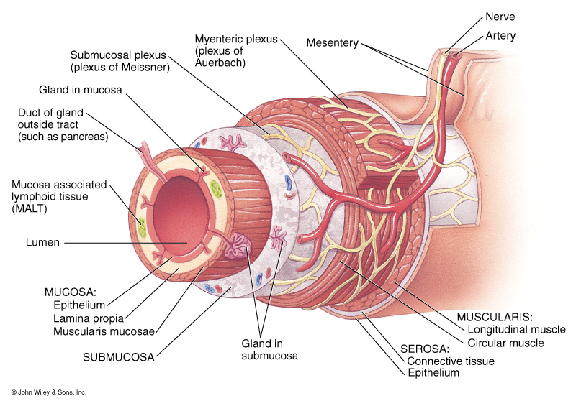

Slide 4
-Mucosa
1-The lumen of the alimentary canal is lined by an epithelium.
2-lamina propria represent the deep region which consist of loose c.t this region is richly by vascular zed, c.t houses glands as well as lymph vessels and occasional lymph nodules.
3-Lamina propria is surrounded by c.t coat is the muscularis mucosa, composed of an inner circular layer and an outer longitudinal layer of smooth muscle.
-Sub mucosa
1-is composed of a dense, irregular fibro elastic c.t layer.
2-this layer houses no glands except in the esophagus and duodenum.
3-sub mucosa contains blood and lymph vessels as well as a component of the enteric nervous system known as Meiss-Ner´s

Slide 5
sub mucosa plexus(controls the motility of the mucosa and secretory activities of its glands).
-Muscularis externa
1-thick muscular layer is invested by the sub mucosa.
2-responsible for peristaltic activity, which moves the contents of the lumen along the alimentary tract.
3-the muscularis externa is composed of smooth muscle(except in the esophagus) and is usually organized in an inner circular layer and outer longitudinal layer.
4-a second components of the enteric nervous system, known as Auerbach´s myenteric plexus, is situated between the two layer and regular the activity of the muscularis externa.

Slide 6
-Serosa or adventitia
1-thin c.t layer is envelope the muscularis externa.
2-if the alimentary canal region is intra peritoneal, it is invested by peritoneum, and the covering is known as the serosa, while if the organ is retroperitoneal, it adheres to the body wall by its adventitia.

